Slide 1

Sound-Activated Switch Using 555 Timer IC
American International University – Bangladesh (AIUB)
DIGITAL LOGIC AND CIRCUITS LAB [Q]
Faculty Name: Md. Shaoran Sayem
Group Number: 03
Group Members:
Name | ID
Amrin Shahwar | 23-53045-3
Jannatul Ferdoush Mayesha | 23-53088-3
Md. Sadat Hossain | 23-54928-3
Maisha Mahjabin | 23-54978-3

Slide 2

Background
The 555 timer IC is a widely used and versatile integrated circuit for timing and switching applications. In this project, the 555 timer is configured in monostable mode to design a sound-activated switch. A condenser microphone detects sound signals, which are amplified using a BC547 transistor to trigger the timer. The timer produces a single output pulse that controls an LED for a fixed duration. This project demonstrates the basic working of sound sensing, signal amplification, and timing control using the 555 timer IC in simple automation applications.

Slide 3
Objectives
To design and implement a sound activated switching circuit using the 555 timer IC.
To study the operation of the 555 timer IC in monostable mode.
To detect sound signals using a condenser microphone and amplify them using a transistor.
To control an LED using the output of the 555 timer IC.
To analyze the effect of timing capacitor value on the output pulse duration.

Slide 4

Components Used
555 Timer IC
Condenser Microphone
Transistor: BC547
Resistors: 100K, 47K, 1K, 330Ω
Capacitor: 10 µF
LED
9V Battery
Breadboard and Connector Wires

Slide 5

Working Principle
When a sound is produced, the condenser microphone converts it into a small electrical signal. This weak signal is amplified by the BC547 transistor and applied as a trigger to pin 2 of the 555 timer IC. The 555 timer, operating in monostable mode, generates a single output pulse at pin 3. The duration of this pulse is determined by the external resistor–capacitor (RC) network connected to the IC. During this time, the output drives the LED, causing it to glow. After the set time interval, the output returns to its original state, and the LED turns OFF, waiting for the next sound input.

Slide 6
Role of 555 Timer IC
Acts as a monostable pulse generator in the circuit.
Receives a trigger pulse from the amplified sound signal.
Produces a single output pulse to control the LED.
Determines the ON duration of the LED based on external resistor and capacitor values.
Serves as the core component for timing and switching in the sound-activated circuit.

Slide 7
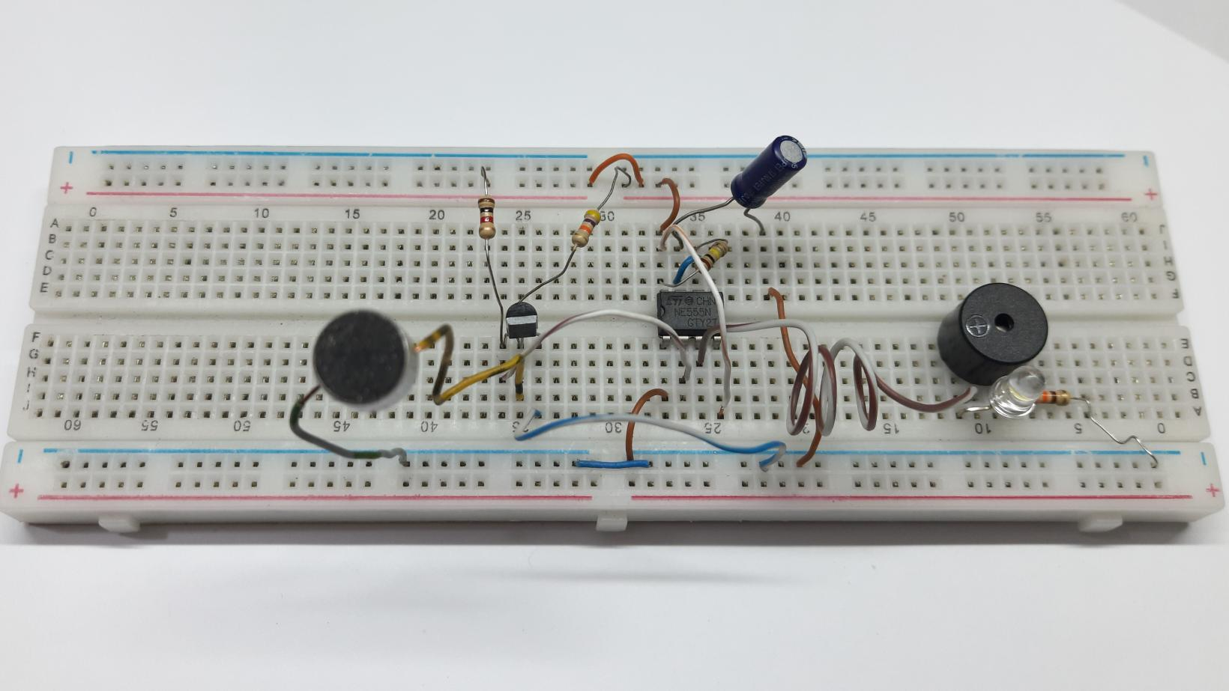
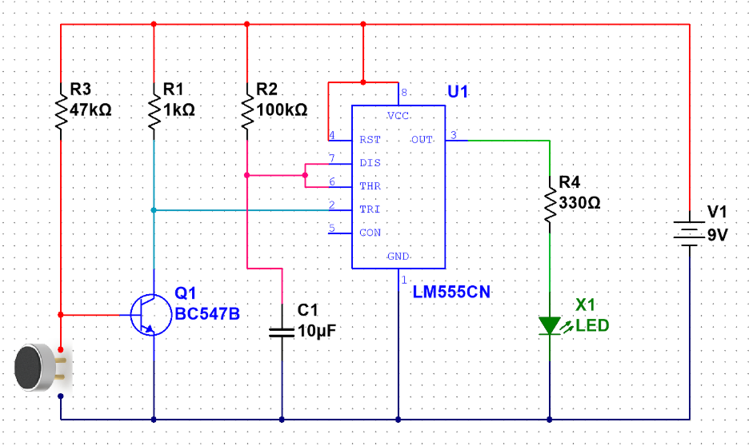
Circuit Description
Place NE555 IC on the breadboard.
Connect Pin 6 → Pin 7, Pin 4 → Pin 8, Pin 8 → +9V, Pin 1 → GND.
Insert BC547 transistor: Collector → Pin 2, Emitter → GND, Base → +9V via 47 kΩ.
Connect microphone: Positive → transistor base, Negative → GND.
Add timing components: 100 kΩ resistor (Pin 6–8), 10 µF capacitor (Pin 7–GND).
Connect LED: Anode → Pin 3, Cathode → GND via 330 Ω.
Connect 1 kΩ resistor between transistor collector and +9V.
Power the circuit with 9V DC.

Slide 8
Applications
Clap-operated lighting systems
Home automation projects
Assistive devices for physically challenged people
Educational electronics experiments

Slide 9
Advantages and Limitations
Advantages
Hands-free operation
Simple and low-cost
Low power consumption
Compact design
Customizable sensitivity
Versatile applications
Limitations
Sensitive to noise
Limited output current
Delay issues
Limited range
Not for high power devices

Slide 10
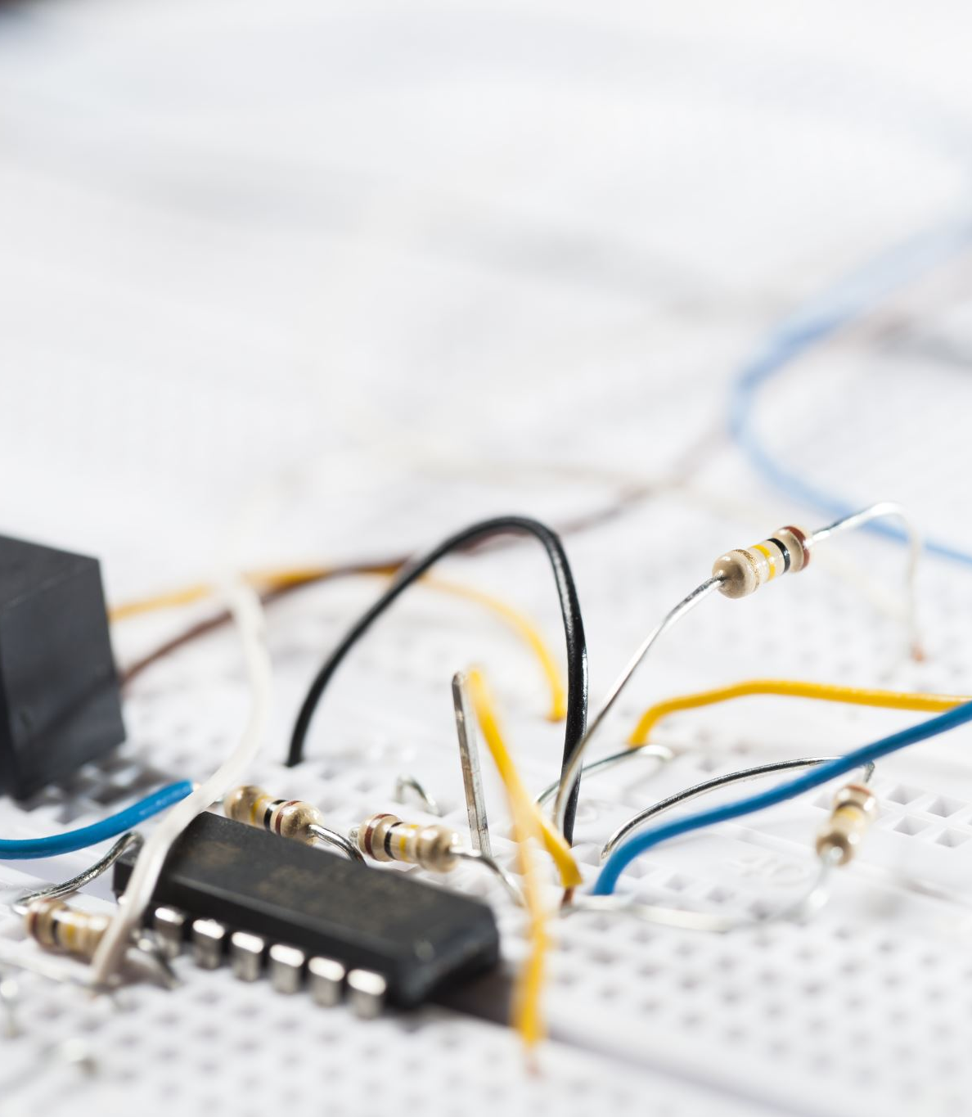
Conclusion
This project successfully demonstrates a simple and effective way to control devices using sound signals. By combining a condenser microphone, a BC547 transistor, and a 555 timer IC, the circuit converts sound into a timed output to drive an LED or other loads. This project also highlights the practical applications of sound sensing, signal amplification, and timer-based switching in automation. It is a low-cost, easy-to-build system that can be applied in home automation, security systems, and energy-saving applications while also providing a valuable learning experience in basic electronics.

